Slide 1
HTTP Request/Response and MIME

Slide 2
HyperText Transfer Protocol (HTTP)
HTTP (Hypertext Transfer Protocol) is perhaps the most popular application protocol used in the Internet (or The WEB).
HTTP is an asymmetric request-response client-server protocol. An HTTP client sends a request message to an HTTP server.
The server, in turn, returns a response message.
In other words, HTTP is a pull protocol, the client pulls information from the server (instead of server pushes information down to the client).
HTTP is a stateless protocol. In other words, the current request does not know what has been done in the previous requests.

Slide 3
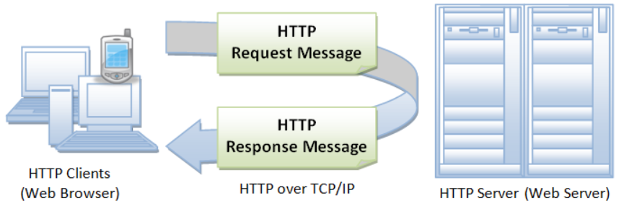

Slide 4
Browser
Whenever you issue a URL from your browser to get a web resource using HTTP,
For e.g. http://www.nowhere123.com/index.html
The browser turns the URL into a request message and sends it to the HTTP server.
The HTTP server interprets the request message, and returns you an appropriate response message, which is either the resource you requested or an error message.

Slide 5
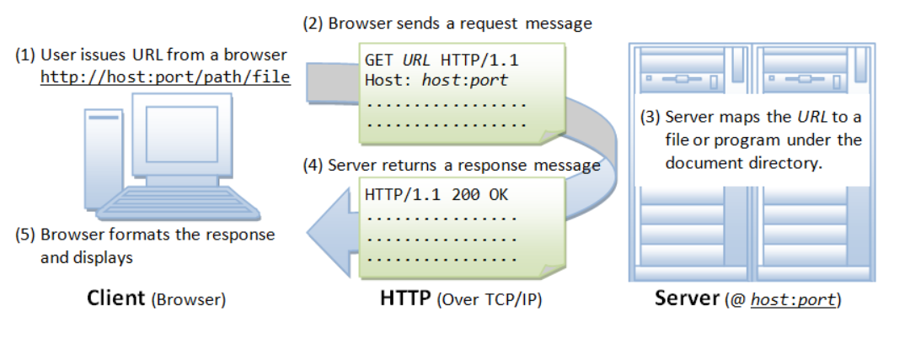

Slide 6
URL
A URL (Uniform Resource Locator) is used to uniquely identify a resource over the web.
protocol://hostname:port/path-and-file-name
There are 4 parts in a URL:
Protocol: The application-level protocol used by the client and server, e.g., HTTP, FTP, and telnet.
Hostname: The DNS domain name (e.g., www.nowhere123.com) or IP address (e.g., 192.128.1.2) of the server.
Port: The TCP port number that the server is listening for incoming requests from the clients.
Path-and-file-name: The name and location of the requested resource, under the server document base directory.

Slide 7
For Example,
In the URL
http://www.nowhere123.com/docs/index.html,
the communication protocol is HTTP;
the hostname is www.nowhere123.com.
The port number was not specified in the URL, and takes on the default number, which is TCP port 80 for HTTP.
The path and file name for the resource to be located is "/docs/index.html".

Slide 8
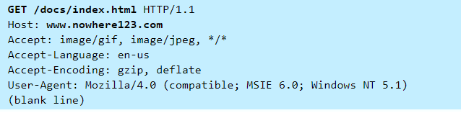
HTTP Request message
For example, the browser translates the following URL into:
http://www.nowhere123.com/doc/index.html

Slide 9
When this request message reaches the server, the server can take either one of these actions:
The server interprets the request received, maps the request into a file under the server's document directory, and returns the file requested to the client.
The server interprets the request received, maps the request into a program kept in the server, executes the program, and returns the output of the program to the client.
The request cannot be satisfied, the server returns an error message.

Slide 10
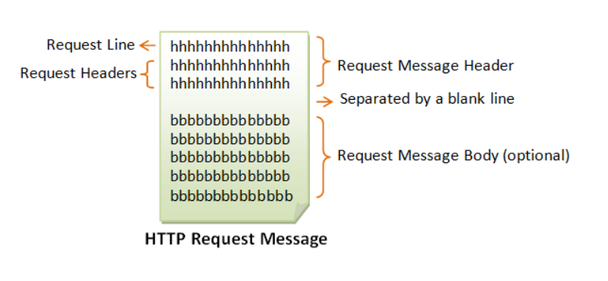

Slide 11
The first line of the header is called the request line, followed by optional request headers.
The request line has the following syntax:
request-method-name request-URI HTTP-version
request-method-name: HTTP protocol defines a set of request methods, e.g., GET, POST, HEAD, and OPTIONS. The client can use one of these methods to send a request to the server.
request-URI: specifies the resource requested.
HTTP-version: Two versions are currently in use: HTTP/1.0 and HTTP/1.1.

Slide 12
HTTP methods:
GET: Retrieve static or dynamic content
Arguments for dynamic content are in URI
Workhorse method (99% of requests)
POST: Retrieve dynamic content
Arguments for dynamic content are in the request body
OPTIONS: Get server or file attributes, Ask the server to return the list of request methods it supports.
HEAD: A client can use the HEAD request to get the header that a GET request would have obtained. Since the header contains the last-modified date of the data, this can be used to check against the local cache copy. Like GET but no data in response body.
PUT: Write a file to the server!
DELETE: Delete a file on the server!
TRACE: Echo request in response body
Server returns diagnostic trace of the actions it takes
Notes:
a machine that operates without failing for long periods, although it might not be very interesting or exciting:
someone who works very hard or who works very long hours

Slide 13
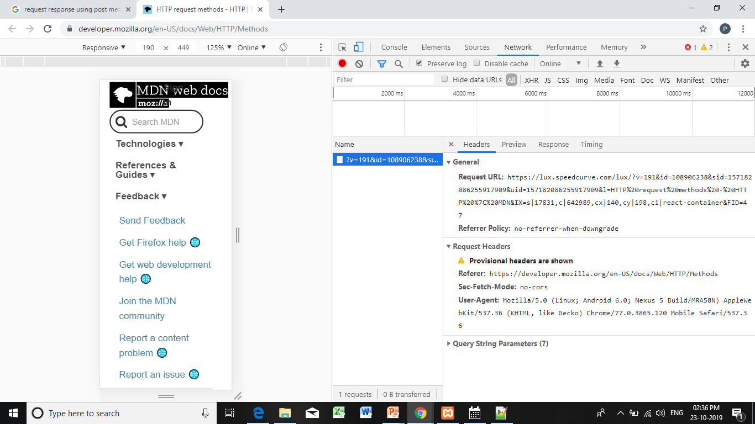

Slide 14
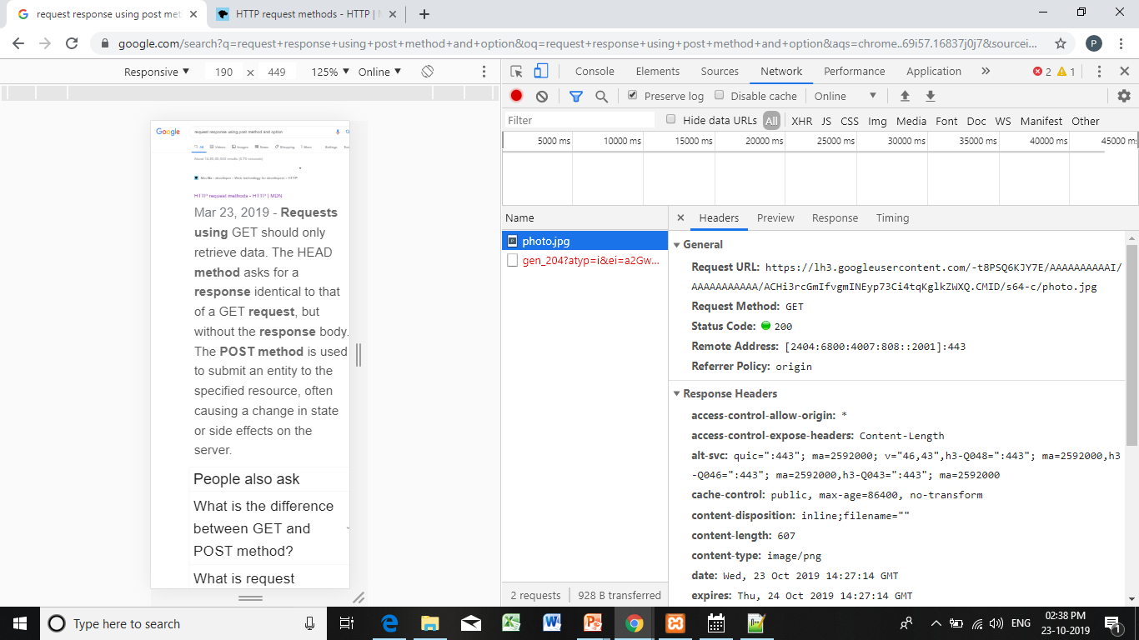

Slide 15
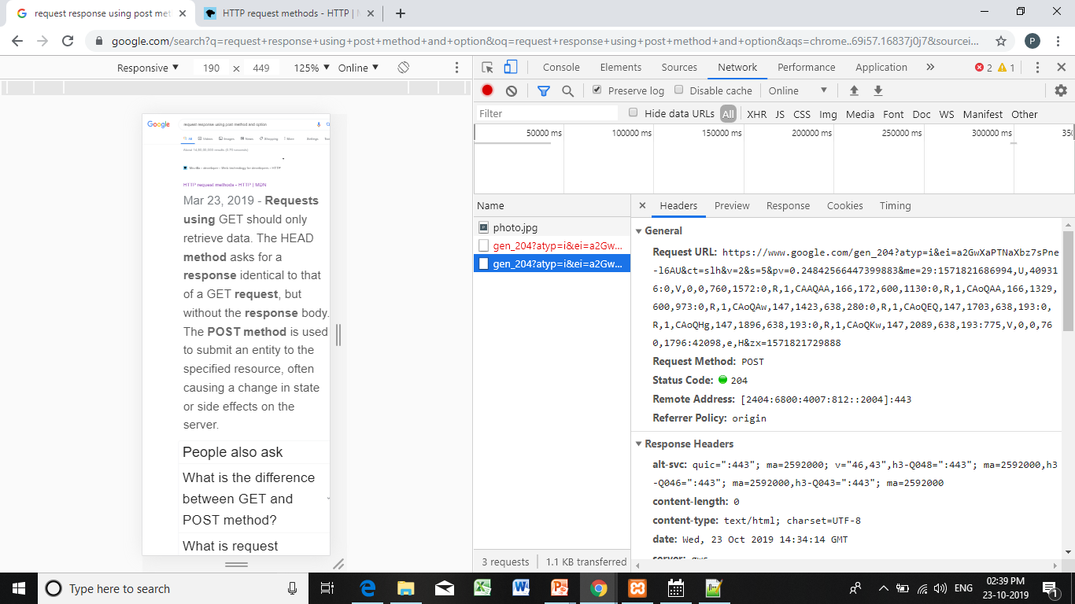

Slide 16
Request headers: <header name>: <header data>
Provide additional information to the server.

Slide 17
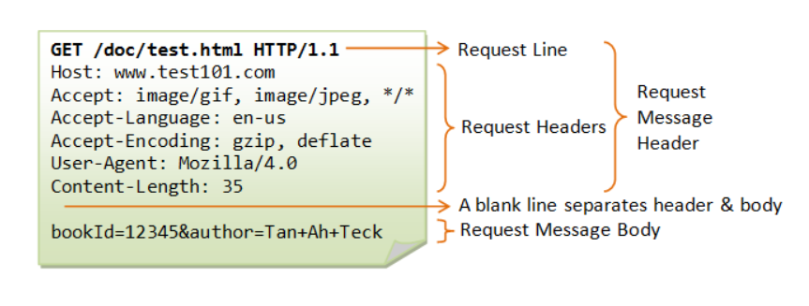

Slide 18
The GET Method
GET is used to request data from a specified resource.
GET requests can be cached
GET requests remain in the browser history
GET requests can be bookmarked
GET requests should never be used when dealing with sensitive data
GET requests have length restrictions
GET requests are only used to request data (not modify)
Only ASCII characters allowed

Slide 19
The POST Method
POST is used to send data to a server to create/update a resource.
The data sent to the server with POST is stored in the request body of the HTTP request:
POST requests are never cached
POST requests do not remain in the browser history
POST requests cannot be bookmarked
POST requests have no restrictions on data length
Binary data is also allowed

Slide 20
The PUT Method
PUT is used to send data to a server to create/update a resource.
The difference between POST and PUT is that PUT requests are idempotent. That is, calling the same PUT request multiple times will always produce the same result. In contrast, calling a POST request repeatedly have side effects of creating the same resource multiple times.

Slide 21
The HEAD Method
HEAD is almost identical to GET, but without the response body.
In other words, if GET /users returns a list of users, then HEAD /users will make the same request but will not return the list of users.
HEAD requests are useful for checking what a GET request will return before actually making a GET request - like before downloading a large file or response body.

Slide 22
HTTP Response message
The browser receives the response message, interprets the message and displays the contents of the message on the browser's window according to the media type of the response (as in the Content-Type response header).
Common media type include,
"text/plain", "text/html", "image/gif", "image/jpeg", "audio/mpeg", "video/mpeg", "application/msword", and "application/pdf".

Slide 23
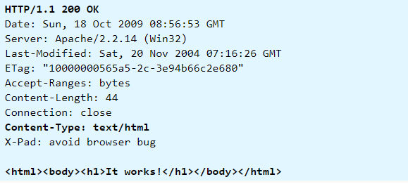

Slide 24
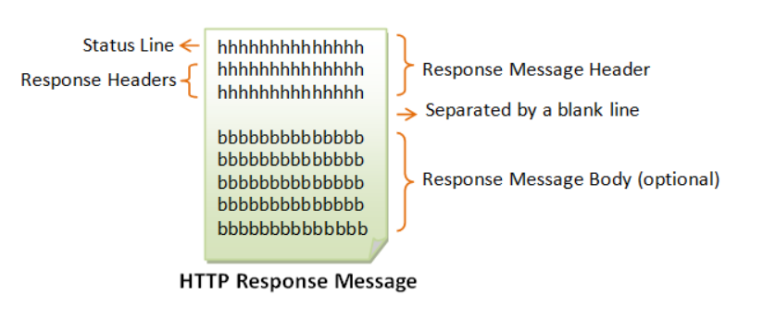

Slide 25
Form:
Status line
Response header fields
blank line
Response body
Status line format:
HTTP version status code explanation
Example: HTTP/1.1 200 OK
(Current version is 1.1)
The header field, Content-type, is required

Slide 26
Status Line
The first line is called the status line, followed by optional response header(s).
The status line has the following syntax:
HTTP-version status-code reason-phrase
HTTP-version: The HTTP version used in this session. Either HTTP/1.0 and HTTP/1.1.
status-code: a 3-digit number generated by the server to reflect the outcome of the request.
reason-phrase: gives a short explanation to the status code.
Common status code and reason phrase are "200 OK", "404 Not Found", "403 Forbidden", "500 Internal Server Error".

Slide 27
Status code is a three-digit number; first digit specifies the general status
1 => Informational
2 => Success
3 => Redirection
4 => Client error
5 => Server error
<status msg> is corresponding English text.
200 OK Request was handled without error
403 Forbidden Server lacks permission to access file
404 Not found Server couldn’t find the file.

Slide 28
Response Headers
The response headers are in the form name:value pairs:
<header name>: <header data>
Provide additional information about response
Content-Type: MIME type of content in response body.
Content-Length: Length of content in response body

Slide 29
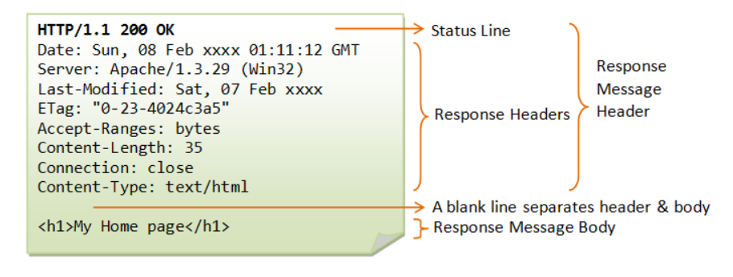

Slide 30
MIME
A media type (also known as a Multipurpose Internet Mail Extensions or MIME type) is a standard that indicates the nature and format of a document, file, or assortment of bytes.
Browsers use the MIME type, to determine how to process a URL, and not the file extension.
So it's important that web servers send the correct MIME type in the response's Content-Type header.
If this is not correctly configured, browsers are likely to misinterpret the contents of files and sites will not work correctly, and downloaded files may be mishandled.

Slide 31
Structure of a MIME type
The simplest MIME type consists of a type and a subtype; these are each strings which, when concatenated with a slash (/) between them, comprise a MIME type. No whitespace is allowed in a MIME type:
type/subtype
The type represents the general category into which the data type falls, such as video or text.
The subtype identifies the exact kind of data of the specified type the MIME type represents.
For example, for the MIME type text, the subtype might be plain (plain text)

Slide 32
Each type has its own set of possible subtypes, and a MIME type always has both a type and a subtype, never just one or the other.
An optional parameter can be added to provide additional details:
type/subtype;parameter=value
For example, for any MIME type whose main type is text, the optional charset parameter can be used to specify the character set used for the characters in the data.

Slide 33
If no charset is specified, the default is ASCII (US-ASCII) unless overridden by the user agent's settings. To specify a UTF-8 text file, the
MIME type text/plain;charset=UTF-8 is used.
MIME types are case-insensitive but are traditionally written in lowercase, with the exception of parameter values, whose case may or may not have specific meaning.

Slide 34
Types
There are two classes of type: discrete and multipart.
Discrete types are types which represent a single file or medium, such as a single text or music file, or a single video.
A multipart type is one which represents a document that's comprised of multiple component parts, each of which may have its own individual MIME type; or, a multipart type may encapsulate multiple files being sent together in one transaction.
For example, multipart MIME types are used when attaching multiple files to an email.

Slide 35
Discrete types
application
Any kind of binary data that doesn't fall explicitly into one of the other types; either data that will be executed or interpreted in some way or binary data that requires a specific application or category of application to use.
Generic binary data (or binary data whose true type is unknown) is application/octet-stream (unknown binary file)
Other common examples include application/pdf, and application/zip.
video
Video data or files, such as MP4 movies (video/mp4).

Slide 36
audio
Audio or music data. Examples include audio/mpeg, audio/vorbis.
font
Font/typeface data. Common examples include font/woff, font/ttf, and font/otf.
image
Image or graphical data including both bitmap and vector still images as well as animated versions of still image formats such as animated GIF or APNG. Common examples are image/jpeg, image/png, and image/svg+xml.
text
Text-only data including any human-readable content, source code, or textual data such as comma-separated value (CSV) formatted data. Examples include text/plain, text/csv, text/javascript, text/css and text/html.
Notes:
Woff-web open font format
Open type font
True type font
Scalable vector graphics
Embedded open type
Animated portable network graphics

Slide 37
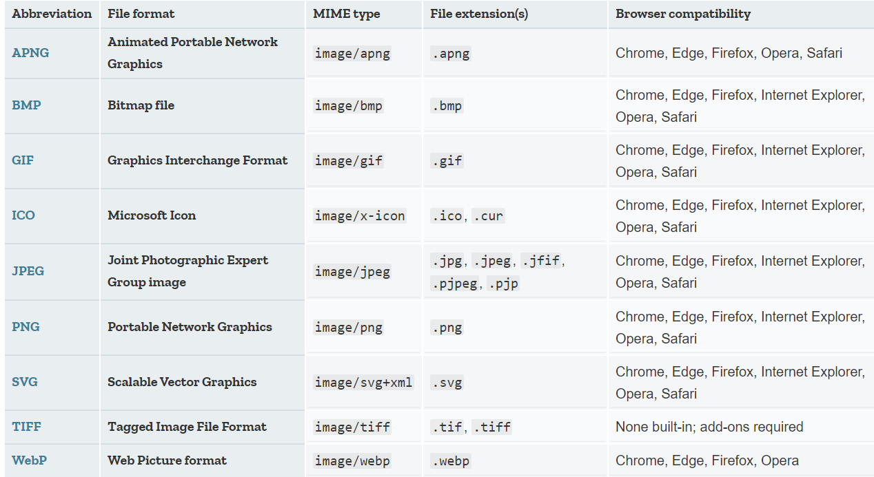

Slide 38
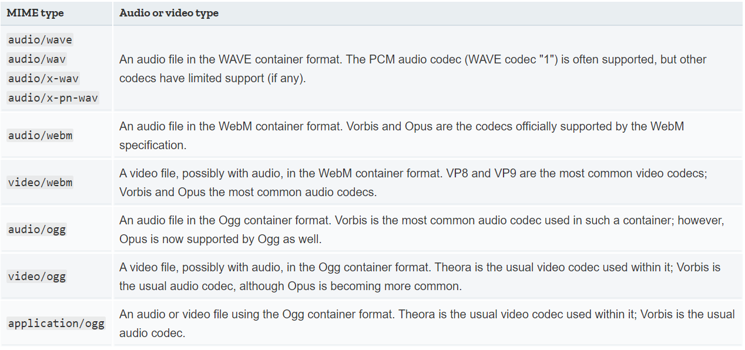

Slide 39
Multipart types
Multipart types indicate a category of document broken into pieces, often with different MIME types; they can also be used — especially in email scenarios — to represent multiple, separate files which are all part of the same transaction.
They represent a composite document.
There are two multipart types:

Slide 40
message
A message that encapsulates other messages.
This can be used, for instance, to represent an email that includes a forwarded message as part of its data, or to allow sending very large messages in chunks as if it were multiple messages.
Examples include message/rfc822 (for forwarded or replied-to message quoting) and message/partial to allow breaking a large message into smaller ones automatically to be reassembled by the recipient.

Slide 41
multipart
Data that is comprised of multiple components which may individually have different MIME types.
Examples include
multipart/form-data (for data produced using the Formdata API)
multipart/byteranges (defined in RFC 7233: 5.4.1 and used with HTTP's 206 (Status code) "Partial Content" response returned when the fetched data is only part of the content, such as is delivered using the Range header).

Slide 42
HTTPD
HTTP Daemon is a software program that runs in the background of a web server and waits for the incoming server requests. The daemon answers the request automatically and serves the hypertext and multimedia documents over the Internet using HTTP.
httpd is the Apache HyperText Transfer Protocol (HTTP) server program. It is designed to be run as a standalone daemon process. When used like this it will create a pool of child processes or threads to handle requests.

Slide 43
The Apache HTTP Server configuration file is /etc/httpd/conf/httpd.conf . The httpd.conf file is well-commented and mostly self-explanatory. The default configuration works for most situations

Slide 44
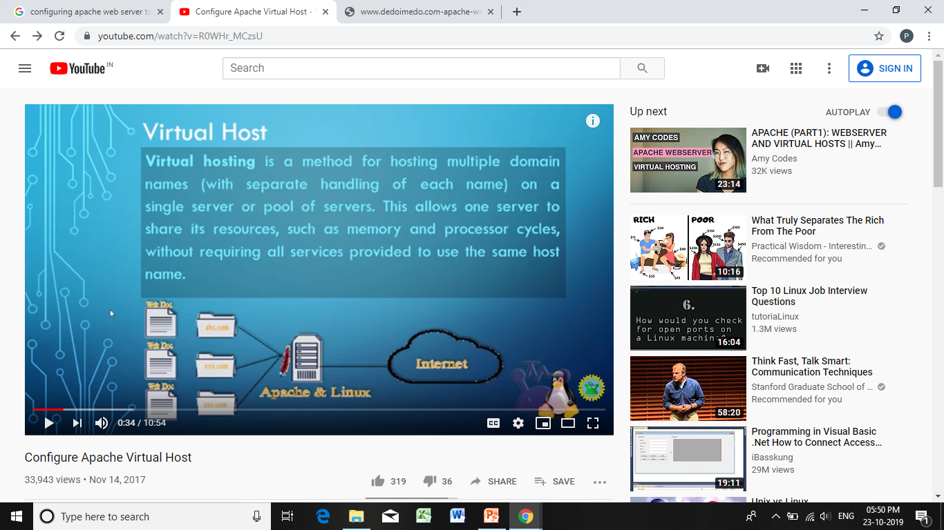

Slide 45
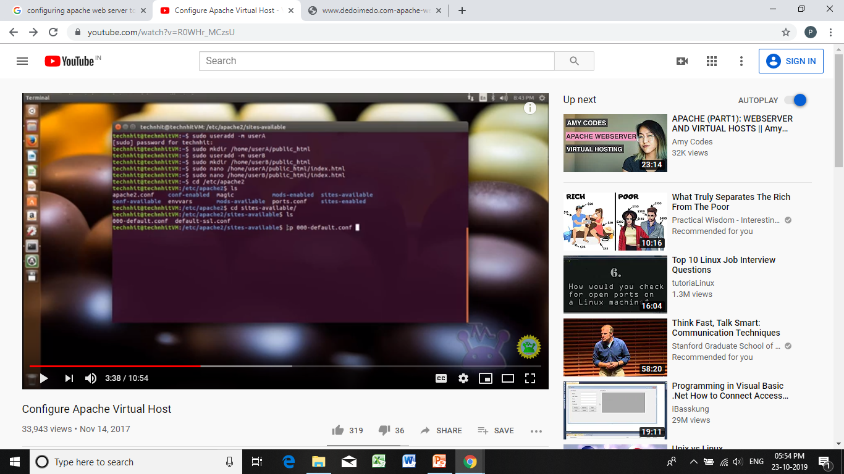

Slide 46
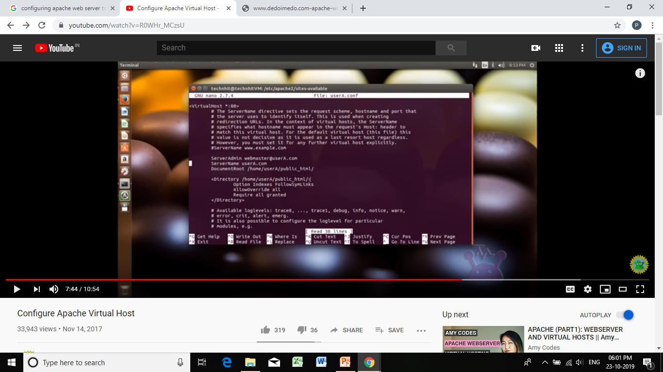

Slide 47
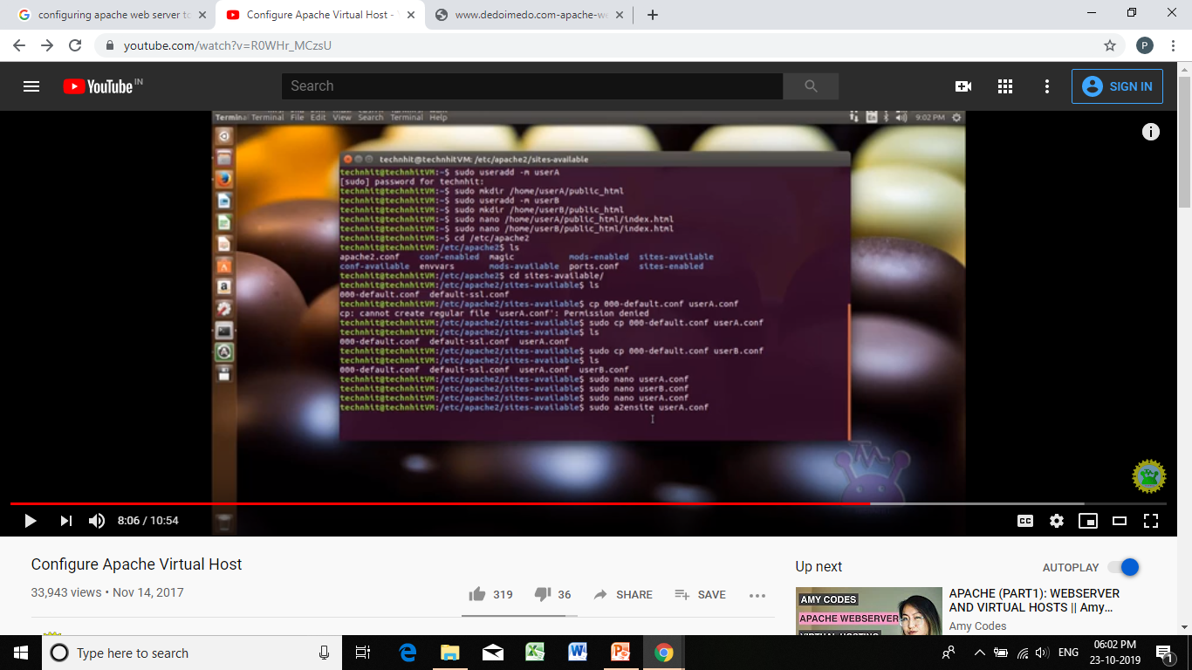

Slide 48
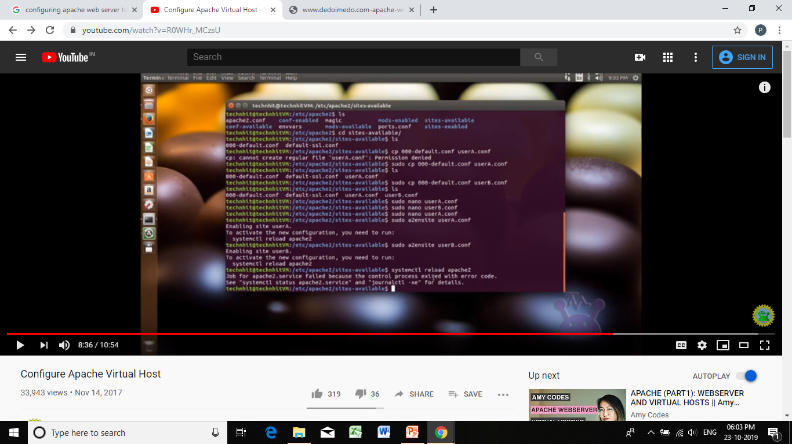

Slide 49
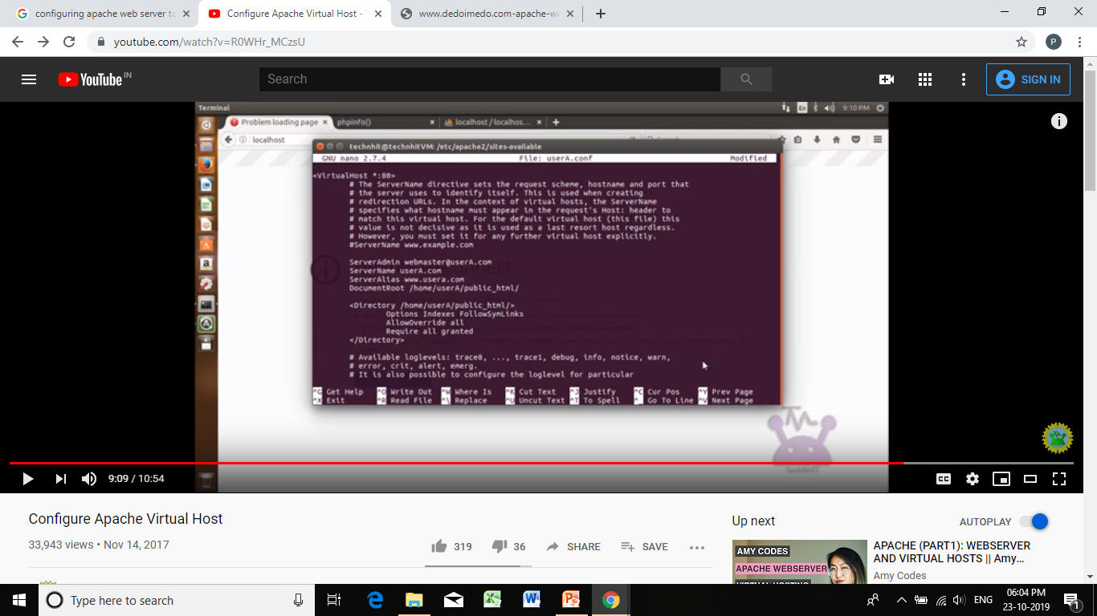

Slide 50
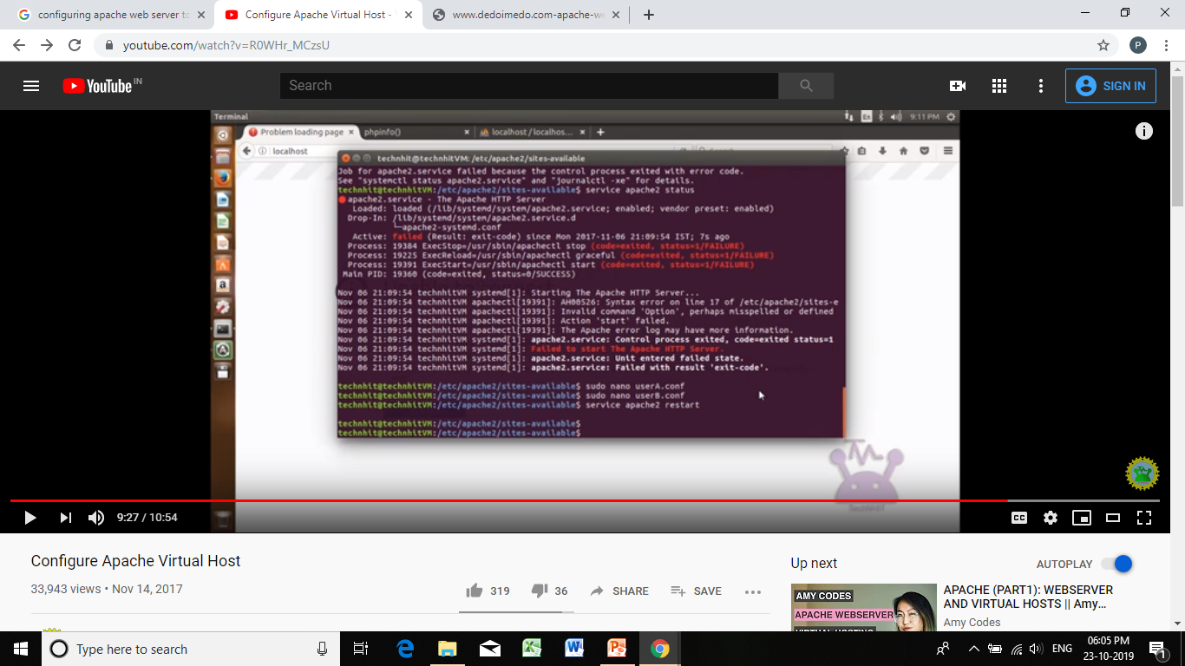

Slide 51
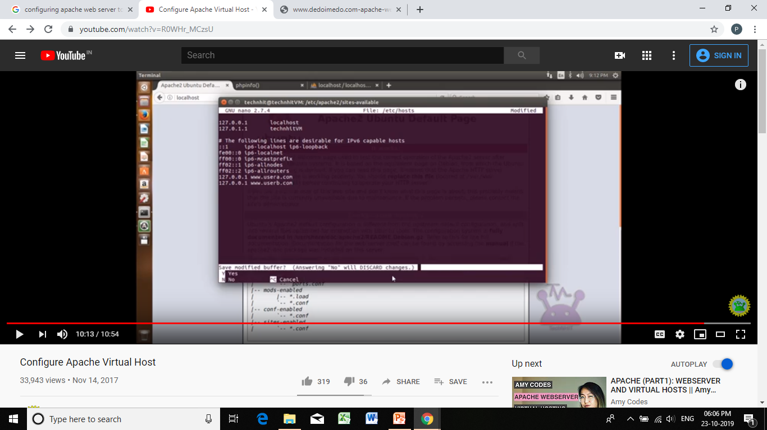

Slide 52
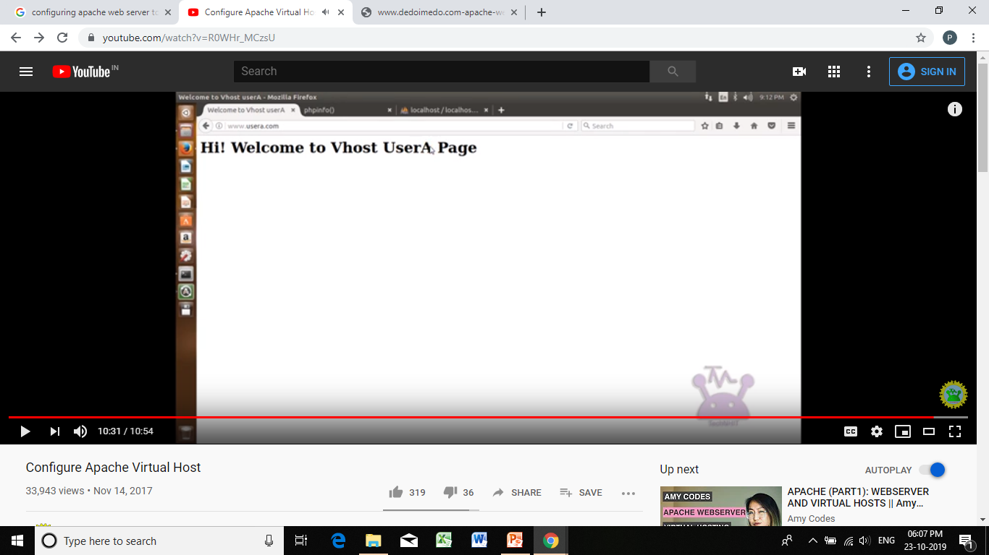

Slide 53
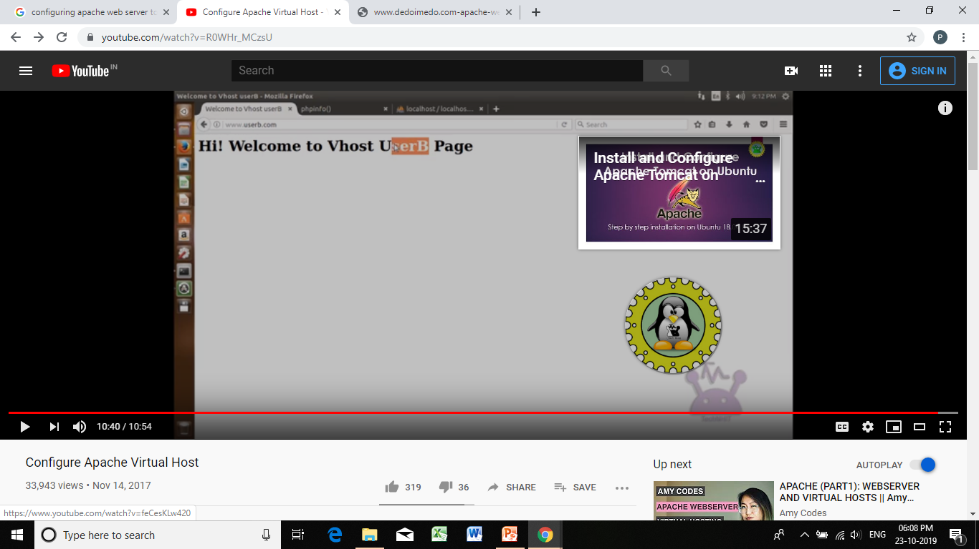

Slide 54
